Slide 1
Data Structures and Algorithms (ESO207)
Lecture 26
Depth First Search (DFS) Traversal
DFS Tree
Novel application: computing biconnected components of a graph

Slide 2
DFS traversal of G
DFS(v)
{ Visited(v) ← true;
For each neighbor w of v
{ if (Visited(w) = false)
{ DFS(w) ;
}
}
}
DFS-traversal(G)
{
For each vertex vϵ V { Visited(v)← false }
For each vertex v ϵ V { If (Visited(v ) = false) DFS(v) }
}
DFN[v] ← dfn ++;
……..;
……..;
dfn ← 0;

Slide 3
Depth First Numbering (DFN)
DFN[x] :
The number at which x gets visited during DFS traversal.
y
v
1
0
10
w
f
2
3
b
4
h
12
11
d
g
u
5
r
8
z
6
9
s
7
c

Slide 4
DFS tree

Slide 5
DFS(v) computes a tree rooted at v
y
v
Is a DFS tree unique for a graph ?
Can any rooted tree be obtained through DFS ?
w
f
b
h
d
No
g
No
u
r
z
s
c
A DFS tree rooted at v

Slide 6
How will an edge appear in DFS traversal ?
as a tree-edge.
If the edge is a non-tree edge :
Edge between ancestor and descendant in
DFS tree.
any other possibility ?
No

Slide 7
How will an edge appear in DFS traversal ?
It can never happen
u
x
y

Slide 8
How will an edge appear in DFS traversal ?
x
y

Slide 9
How will an edge appear in DFS traversal ?
A
y
v
w
f
b
h
d
g
x
y
z
s
c

Slide 10
How will an edge appear in DFS traversal ?
A short proof:
Let (x,y) be a non-tree edge.
Let x get visited before y.
Question:
If we remove all vertices visited prior to x, does y still lie in the connected component of x ?
Answer: yes.
➔
DFS pursued from x will have a path to y in DFS tree.
Hence x must be ancestor of y in the DFS tree.

Slide 11
Always remember
the following picture for DFS traversal
non-tree edge
This is called DFS representation of the graph.
It plays a key role in the design of every efficient algorithm.
➔ back edge

Slide 12
A novel application of DFS traversal
Determining if a graph G is biconnected

Slide 13
Definition: A connected graph is said to be biconnected
if there does not exist any vertex whose removal disconnects the graph.
Motivation: To design robust networks
(immune to any single node failure).

Slide 14
Is this graph biconnected ?
y
v
w
No.
f
b
h
d
g
u
r
z
s
c

Slide 15

A trivial algorithms for checking bi-connectedness of a graph
For each vertex v, determine if G\{v} is connected
(One may use either BFS or DFS traversal here)
Time complexity of the trivial algorithm : O($mn$)

Slide 16

An O($m+n$) time algorithm
A single DFS traversal

Slide 17

An O($m+n$) time algorithm
A formal characterization of the problem.
(articulation points)
Exploring relationship between articulation point & DFS tree.
Using the relation cleverly to design an efficient algorithm.

Slide 18
This graph is NOT biconnected
The removal of any of {v,f,u} can destroy connectivity.
v,f,u are called the articulation points of G.
y
v
w
f
b
h
d
g
u
r
z
s
c

Slide 19
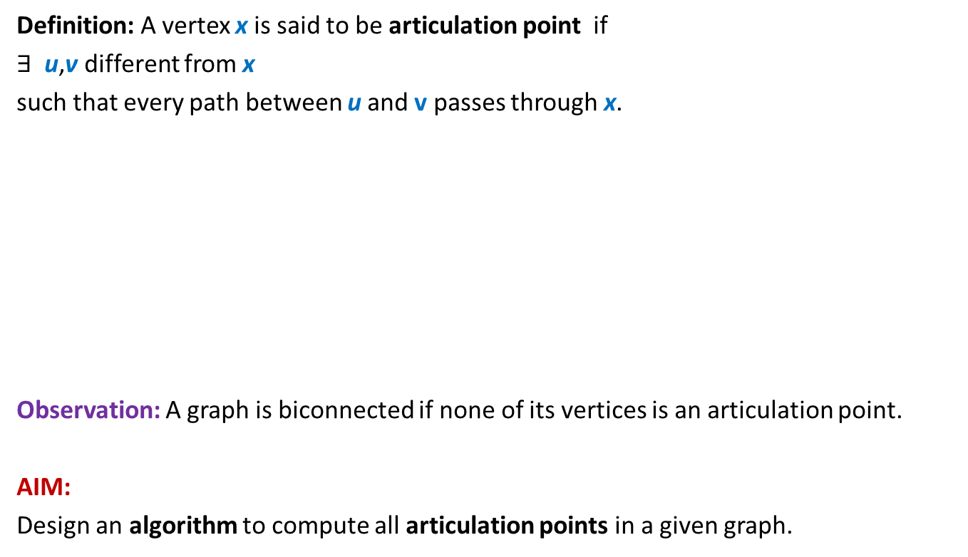
A formal definition of articulaton point
Definition: A vertex x is said to be articulation point if
$∃$ u,v different from x
such that every path between u and v passes through x.
Observation: A graph is biconnected if none of its vertices is an articulation point.
AIM:
Design an algorithm to compute all articulation points in a given graph.
u
x
v

Slide 20
Articulation points and DFS traversal
Don’t Focus on the graph. Instead,
focus on the DFS tree representation of the graph.

Slide 21
Some observations
Question: When can a leaf node be an a.p. ?
Answer: Never
Question: When can root be an a.p. ?
v

Slide 22
Some observations
Question: When can a leaf node be an a.p. ?
Answer: Never
Question: When can root be an a.p. ?
v

Slide 23
Some observations
Question: When can a leaf node be an a.p. ?
Answer: Never
Question: When can root be an a.p. ?
Answer: Iff it has two or more children.
v

Slide 24
Some observations
AIM:
To find necessary and sufficient conditions for an internal node to be articulation point.
u
x
v
How will x look like in DFS tree ?

Slide 25
conditions for an internal node to be articulation point.
root
Where will u and v be relative to x ?
At least one of u and v must be descendant of x.
x

Slide 26
Case 1: Exactly one of u and v is a descendant of x in DFS tree
root
v
Can there be a back edge from T1 to ancestor of x ?
y
u—w—y—v :
a u-v path not passing through x
x
No
u
w
T1

Slide 27
Case 2: both u and v are descendants of x in DFS tree
root
root
x
Can u and v belong to T1 simultaneously?
v
u
No
T1

Slide 28
Case 2: both u and v are descendants of x in DFS tree
root
z
u—w—z—y—q—v :
a u-v path not passing through x
y
At least one of T1 and T2 have no back edge to ancestor of x
x
u
v
w
q
T1
T2

Slide 29
Necessary condition for x to be articulation point
root
Necessary condition:
x has at least one child y s.t.
there is no back edge
from subtree(y) to ancestor of x.
v
x
Is this condition sufficient also ?
u
y
yes.

Slide 30
Articulation points and DFS
Let G=(V,E) be a connected graph.
Perform DFS traversal from any graph and get a DFS tree T.
No leaf of T is an articulation point.
root of T is an articulation point if and only if it has more than one child.
For any internal node … ??
Theorem1 : An internal node x is articulation point if and only if
it has a child y such that
there is no back edge
from subtree(y) to any ancestor of x.

Slide 31
Efficient algorithm for Articulation points
Use Theorem 1
Exploit recursive nature of DFS
Ponder over it before next lecture ☺

